Slide 1



Slide 2
Marim Elhanafy
201803468
Honor Program Student
Major: Computer Engineering
1st Minor: Statistics
2nd Minor: Railway Engineering
Academic Supervisor: Prof. Noora Fetais
Software Department
Mentors: Serdar Kacka and Sanberk Dever

Slide 3


Slide 4
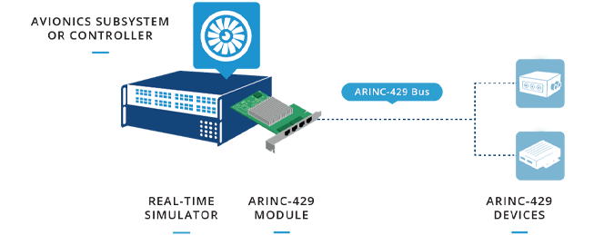

Slide 5
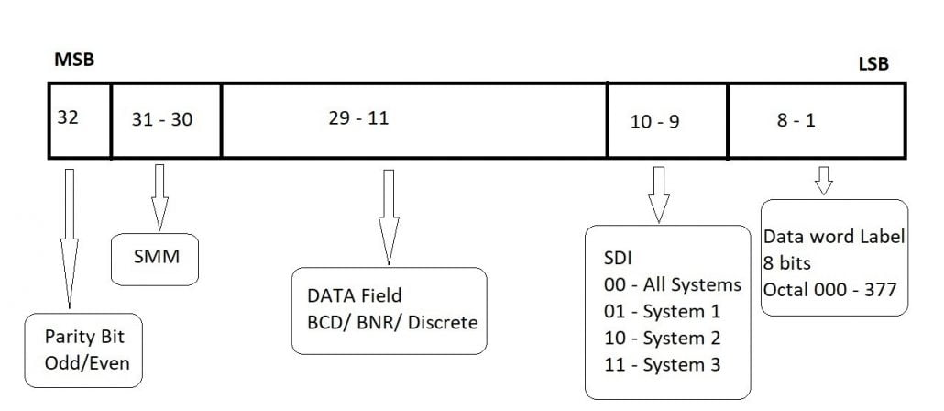
ARINC 429 Word

Slide 6
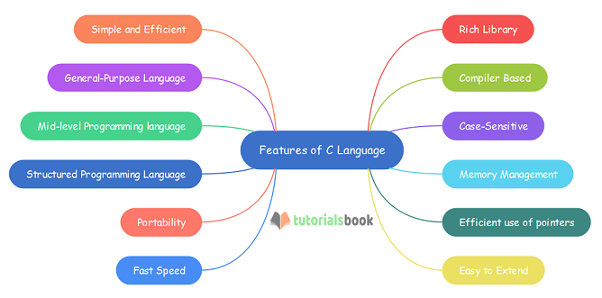


Slide 7
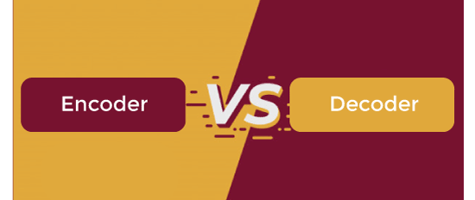

Slide 8
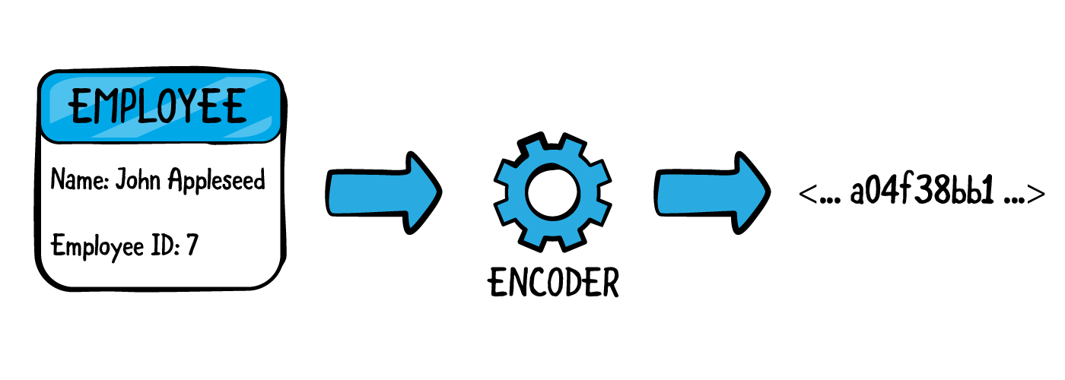

Slide 9
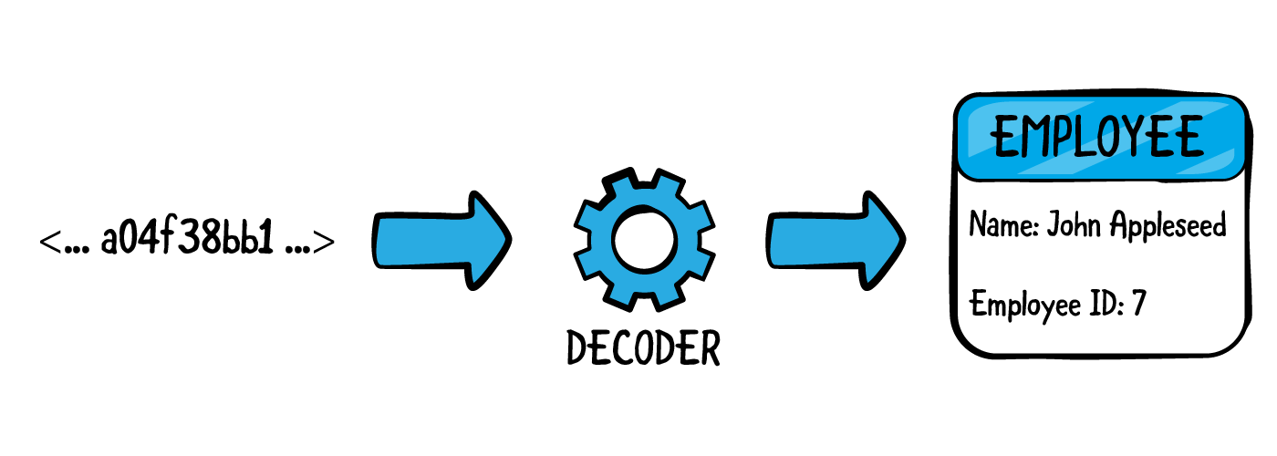

Slide 10


